Slide 1
Types of Business Intelligence Tools and Applications
Ad hoc analysis
Online Analytical processing
Mobile BI
Real time BI
Operation Intelligence
Open-Source BI
Embedded BI
Collaborative BI
Location Intelligence
Business intelligence vendors and market
Sehrish Aqeel
www.aisciences.io

Slide 3
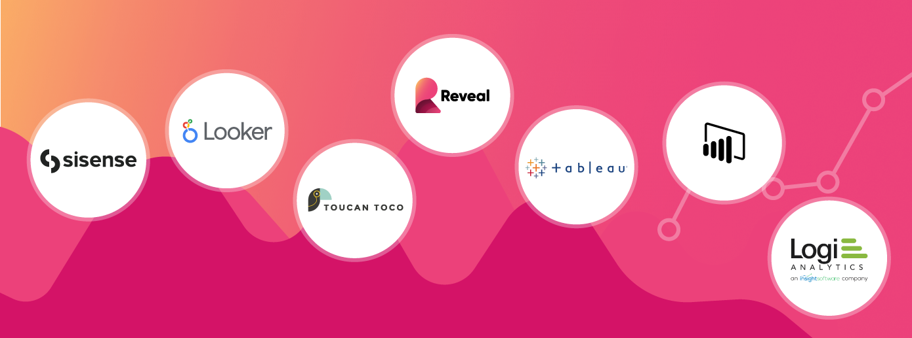
Embedded analytics platforms are a set of business intelligence (BI) capabilities and data visualization tools designed to deliver real-time reporting and advanced analytics including machine learning and AI (artificial intelligence) to users, providing them with insights in the context of their workflow.
The primary purpose of the embedded analytics platforms is to provide data and insights in a simple and easy-to-understand way so that all users, including those with no analytic knowledge or skills, can use it to guide their decision-making.

Slide 4
